Slide 1


PlasticO:
An ontology for plastic and plastic pollution
5th Ontologies4Chem Workshop 2026
Giorgio A. Ubbiali and Ludger Jansen
PTH Brixen College
Project funded by the Autonomous Province of Bolzano–Alto Adige
(Klimaplan, no. 19/2025)
November 3rd, 2026, Hesse, Germany.

Slide 2
Contents
Introduction
The ClimOO Ontology Suite
The Design Methodology
The PlasticO Module
Conclusions and Next Steps

Slide 3

Plastics and Plastic Pollution
Plastics are largely used and beneficial in disparate fields, including constructions, agriculture, and daily use.
Several pollution concerns.
  Alteration of soil biogeochemical element cycles.
  Greenhouse gas emissions.
  Water contamination and trophic transfer of microplastics.
  Microplastic infiltration of organisms' bodies.
  Mutual interconnections with climate change.
(Eerkes-Medrano & Thompson, 2018 ; FAO, 2021; Filipe et al., 2023; Hartmann et al., 2019; Kelly et al., 2025; Lakhiam et al., 2024; Masterton et al., 2023; Ojukwu et al., 2024; Rochman et al., 2019 Yu et al., 2022; Yuan et al., 2022)

Slide 4
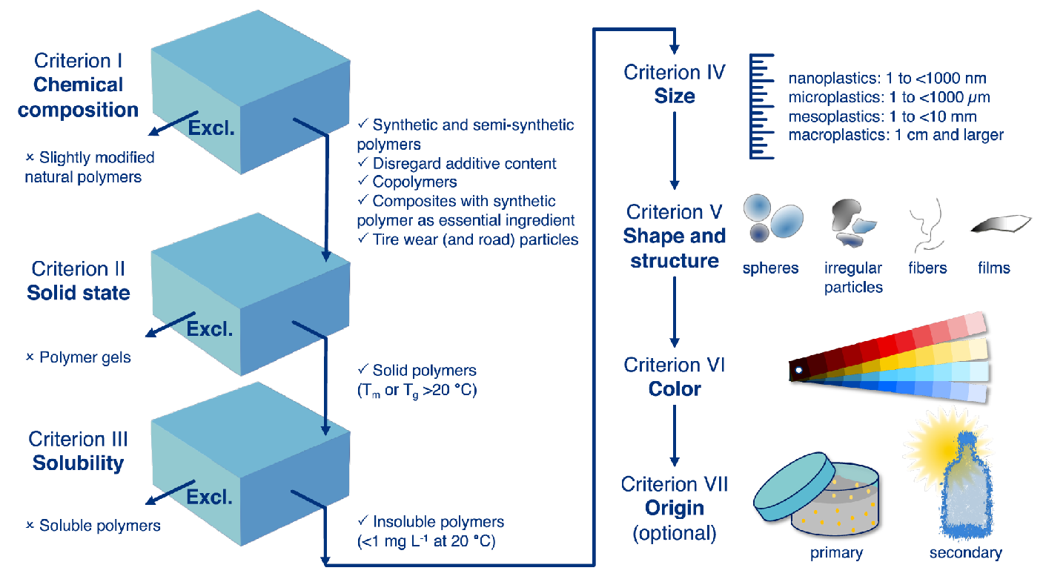
Plastics and Climate Change Semantics
Cross-domain studies.
  Vague terminologies.
  Disparate standards of reference.
  Various systems of classification.
An attractive opportunity: Ontologies.
But to date, no ontology addresses plastic pollution and its interrelations with climate change.
An account of plastic debris. From Hartman et al. (2019).

Slide 5

The ClimOO Ontology Suite
A reference ontology suite for representing plastics, (micro-)plastic pollution, climate change, and their interrelations.
Use case: agrifood systems; South Tyrolean (Italy) apple production.
Ontology Repo: https://w3id.org/climoo/repo
ClimOO Project: https://pthsta.it/climoo
English + Web Ontology Language (OWL).
Source:https://pthsta.it/climoo

Slide 6
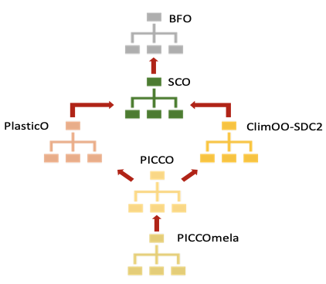
The ClimOO Suite Architecture
A modular structure:
Plastics Ontology (PlasticO),
ClimOO-SDC2,
Plastics Interconnecting with Climate Change Ontology (PICCO),
PICCOmela.
Extending Basic Formal Ontology (BFO) and Sustainability Core Ontology (SCO).
Fig. The ClimOO Ontology suite structure. From Ubbiali and Jansen (2026b).

Slide 7
The ClimOO Methodology
Sustainable Meat Systems Ontology (SuMSO) methodology (Ubbiali et al., 2026).
  Based on existing standards and methodologies such as METHONTOLOGY and the OTK methodology.
Assessment of the relevant literature and major international standards.
Stakeholder engagement.
Reasoner validation and Competency Questions (CQs).
Imports from existing resources, including EnvO, ChEBI, and PMDco.
OBO Foundry principles.
(Fernández-López et al., 1997; Staab et al., 2001; Ubbiali et al., 2026)

Slide 8

The PlasticO Module
Domain of reference: plastics and plastic life cycles, plastic debris, and plastic pollution processes.
Transdisciplinary approach.
Extending SCO and BFO and importing from 14 ontologies, mainly from the OBO Foundry and BFO environments.
463 classes, 273 object properties, and 8 individuals.
https://www.w3id.org/climoo/climoo-plastico
Fig. The PlasticO module.

Slide 9
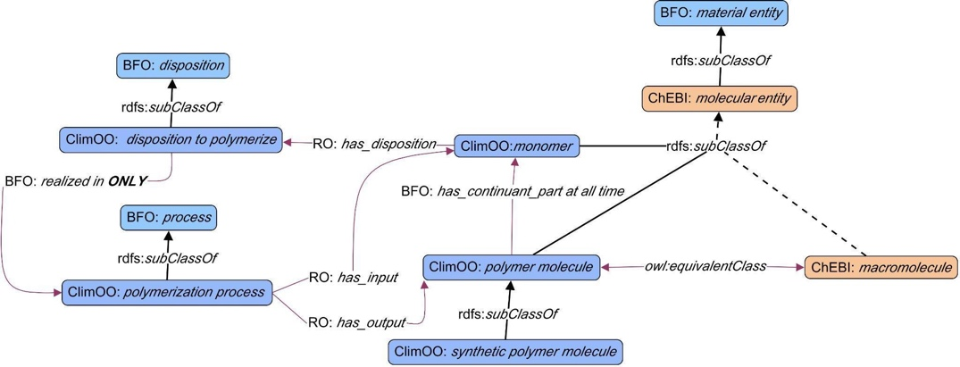
Polymers Molecules
Boxes: classes
Bold arrows: indirect is_a
Dashed arrows: indirect is_a
Red arrows: other relations
Fig. Polymers and monomers From Ubbiali and Jansen (2026a).

Slide 10
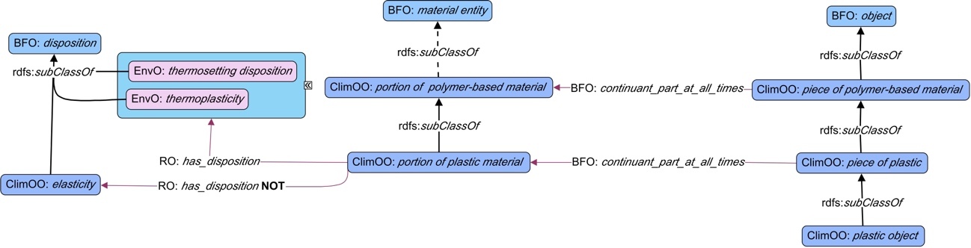
Plastics and Pieces of Plastics
Fig. Portions and pieces of plastic. From Ubbiali and Jansen (2026a).

Slide 11
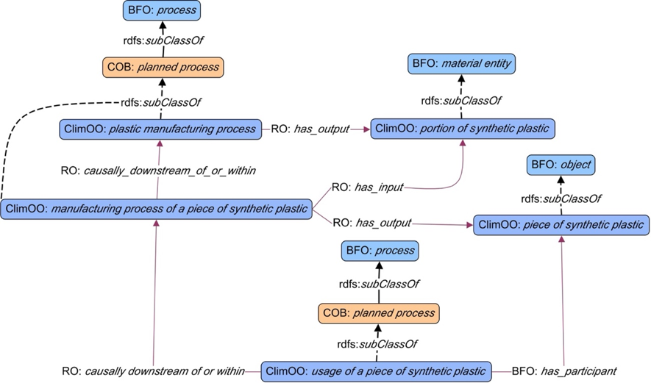
Plastic Life Cycle
Fig. Plastic life cycle. From Ubbiali and Jansen (2026b).

Slide 12
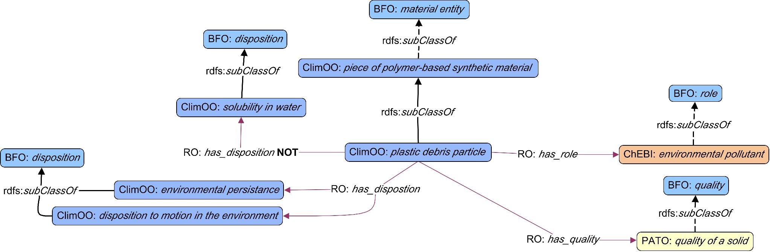
Plastic Debris
Fig. Plastic debris particles. From Ubbiali and Jansen (2026a).

Slide 13
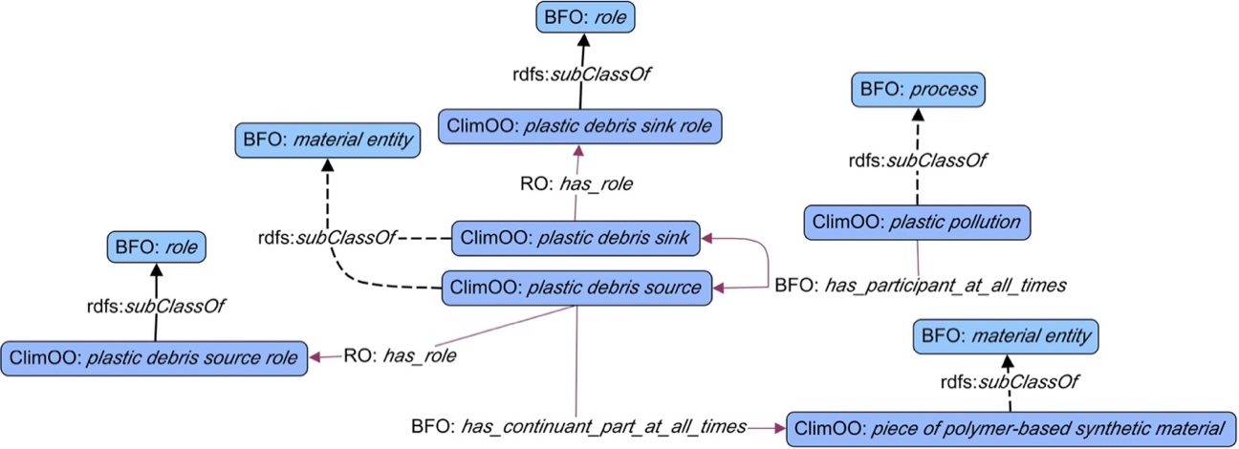
Plastic Pollution
Fig. Plastic pollution. From Ubbiali and Jansen (2026b).

Slide 14
Conclusions and Ongoing Works
The design of an ontology suite for plastic pollution and climate change: ClimOO.
Ongoing works:
  Construction of the PICCO and PICCOmela modules.
  SPARQL queries for CQs testing.
  Stakeholder approval.
  Use case datasets for ontology implementation.
COSMOS: A Community of Common Ontologies, Semantics, and MOdels for Sustainability.

Slide 15

References and Slide Deck
https://github.com/ClimOO/ClimOO-Ontology/tree/main/ClimOO%20material/materials%20from%20ClimOO%20presentations/5th%20Ontologies4Chem%20Workshop

Slide 16
Thank You!!
Giorgio.Ubbiali@pthsta.it

